Slide 1



Altair's Data Science Contest - Pragyan'25
National Institute of Technology, Tiruchirappalli
Tools used
Problem Title
Altair’s
RapidMiner AI Studio
Predicting Burnout Risk Among Tech Professionals
Author
Abhi Priya Darshini Kurasa
Certification Link:
Click here

Slide 2

Problem Statement
Objective
Analyze Mental Health in Tech dataset.
Predict burnout risk.
Identify workplace factors influencing burnout.
Burnout among tech professionals is rising due to high workloads and stress, leading to decreased productivity and well-being. This project aims to predict burnout risk using machine learning in Altair’s RapidMiner AI Studio by analyzing key mental health indicators. The goal is to provide data-driven insights to help organizations implement proactive burnout prevention strategies.
Tools Used
RapidMiner AI Studio: Automated ML & custom model workflows.
Python & Excel: Preprocessing & additional analysis.

Slide 3

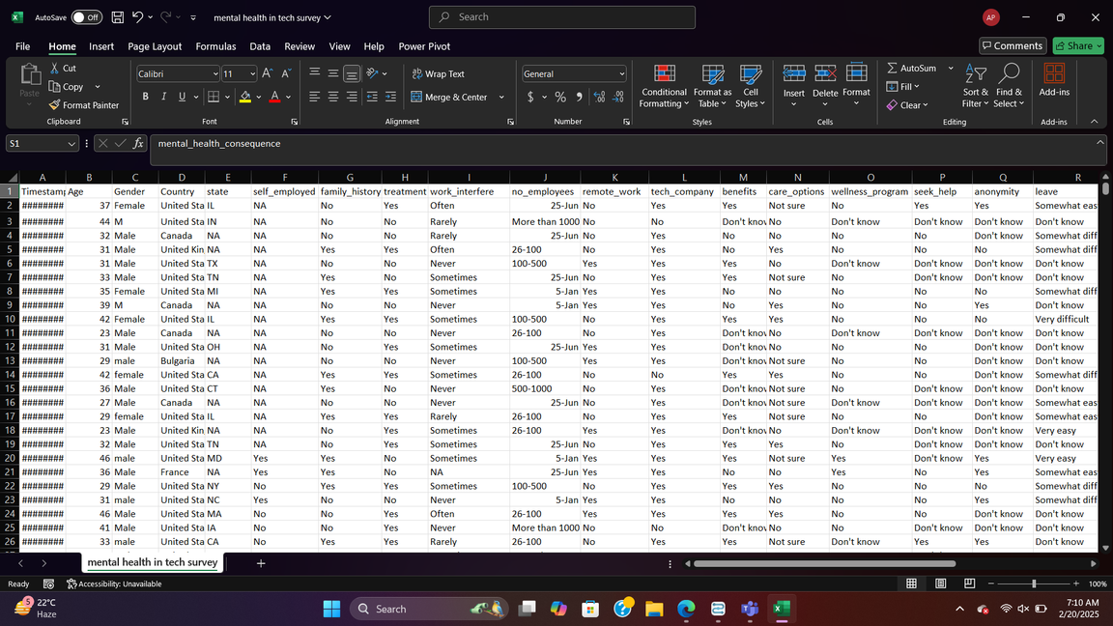
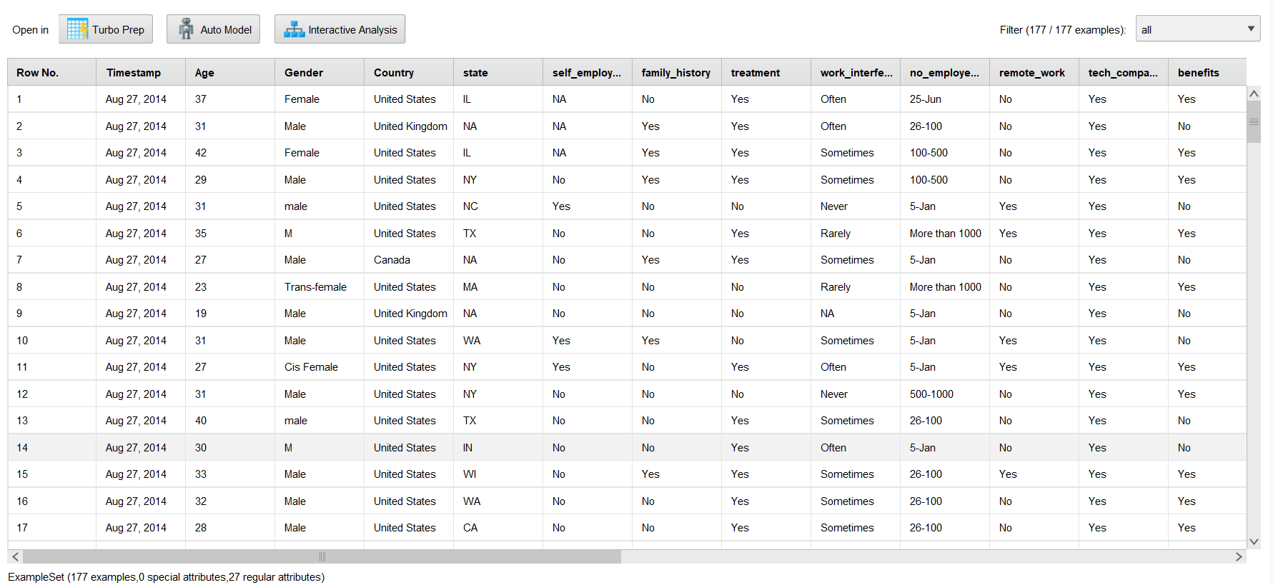
Dataset Description
Total Attributes: 27 features
Categories:
Demographics: Age, Gender, Country, State
Work Details: Employment type, Company size, Remote work
Mental Health Factors: Family history, Past treatment, Work interference
Company Support: Benefits, Care options, Leave policies
Impact & Perception: Health consequences, Supervisor & coworker support
Additional Feedback: Comments
Goal: Analyze workplace mental health trends.
Data set Link: Click Here

Slide 4
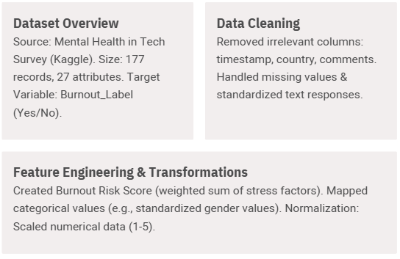
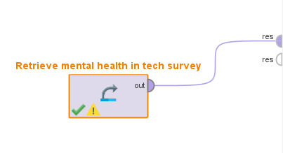
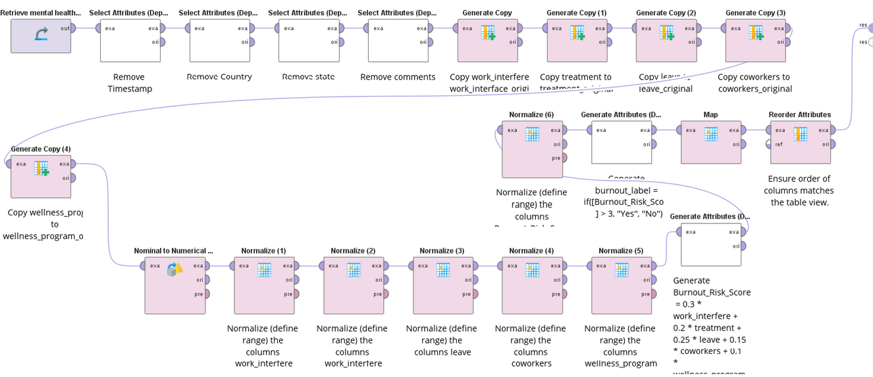
Preparing the Data
Feature Engineering
Burnout_Risk_Score = 0.3 * work_interfere + 0.2 * treatment + 0.25 * leave + 0.15 * coworkers + 0.1 * wellness_program
burnout_label = if([Burnout_Risk_Score ] > 3, "Yes", "No")

Slide 5
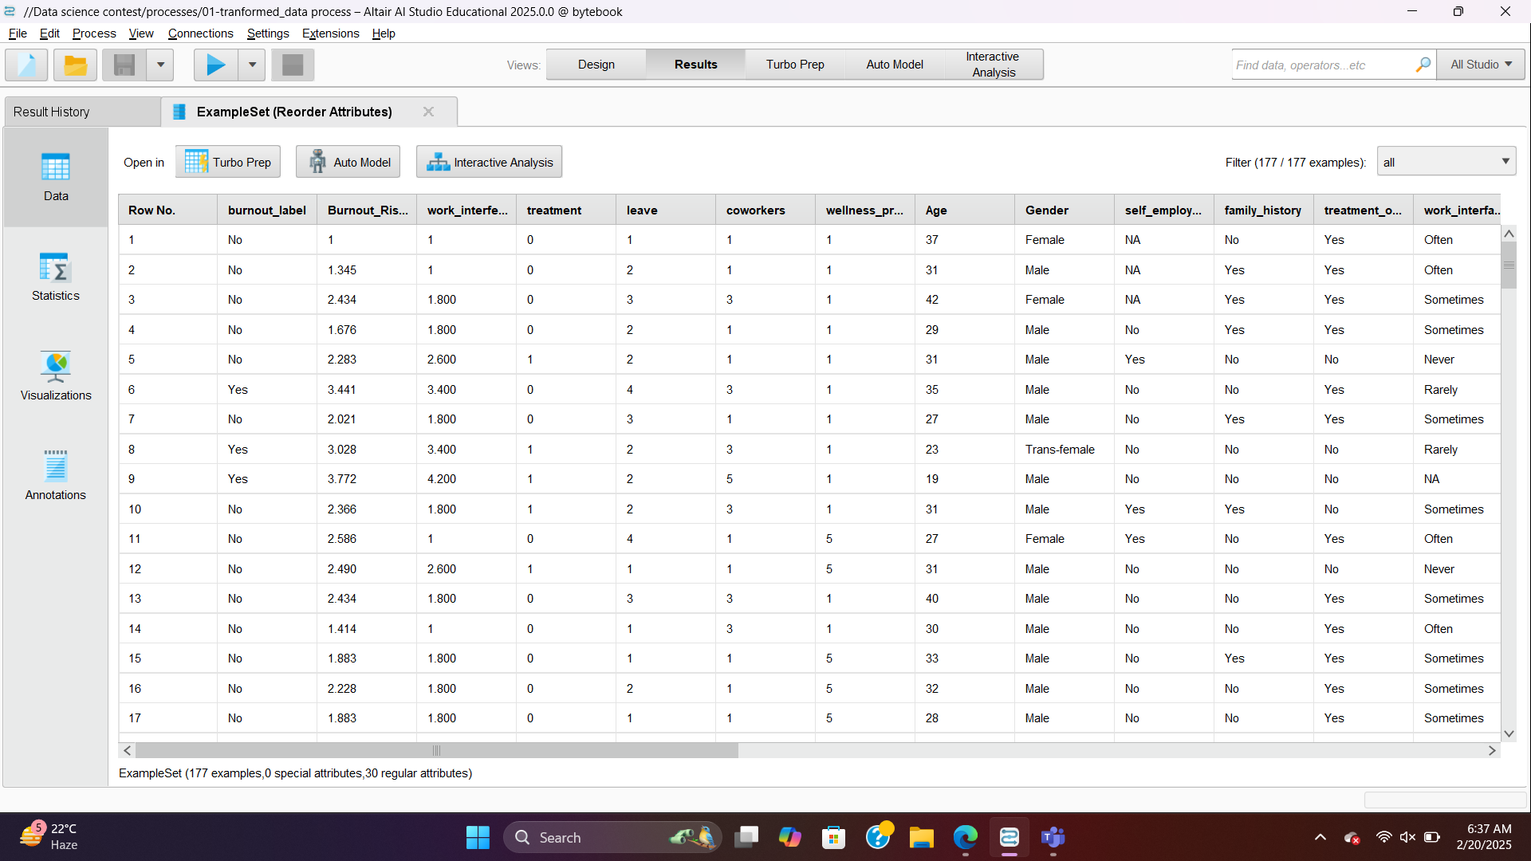
Transformed Data

Slide 6

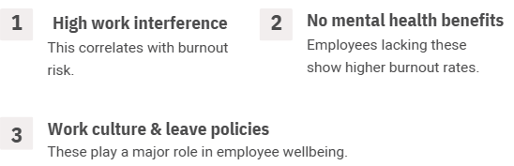
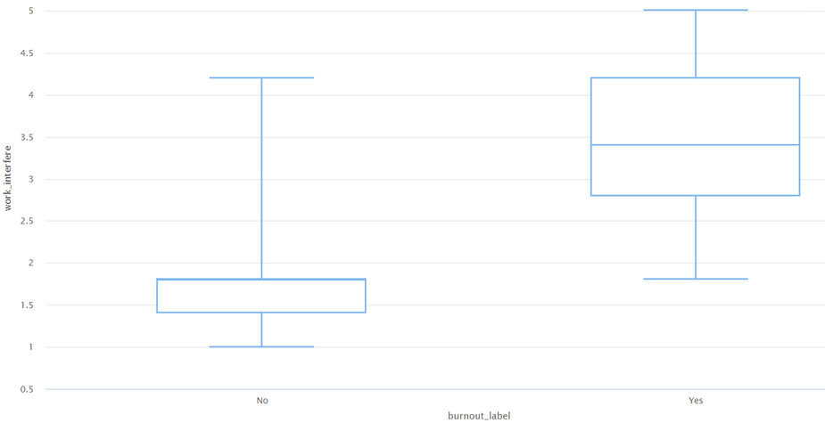
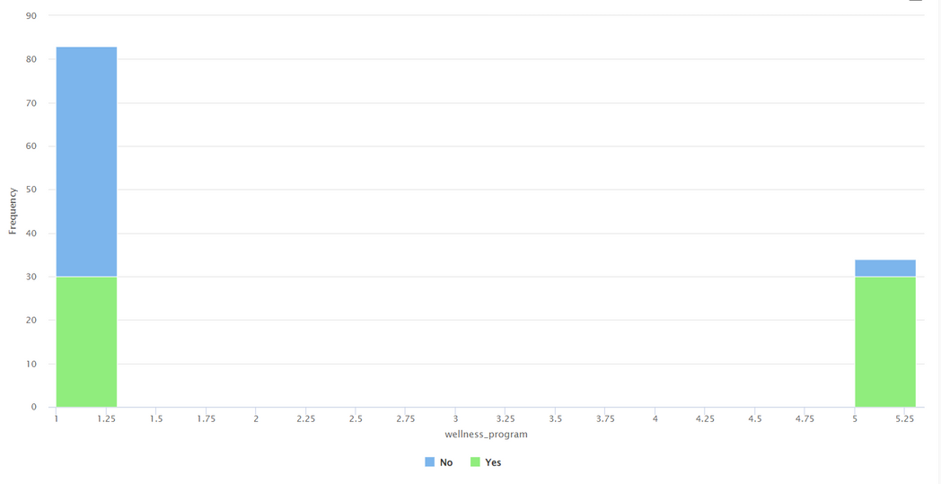
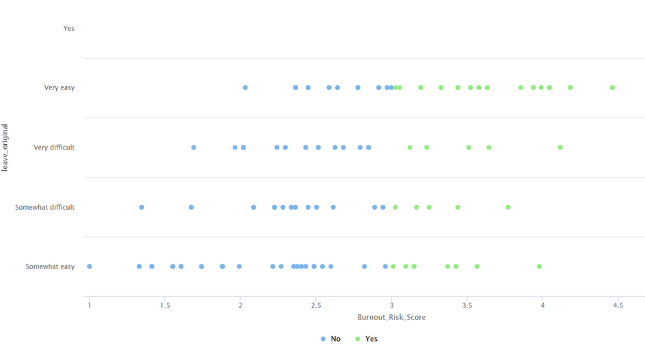
Exploratory Data Analysis (EDA)

Slide 7
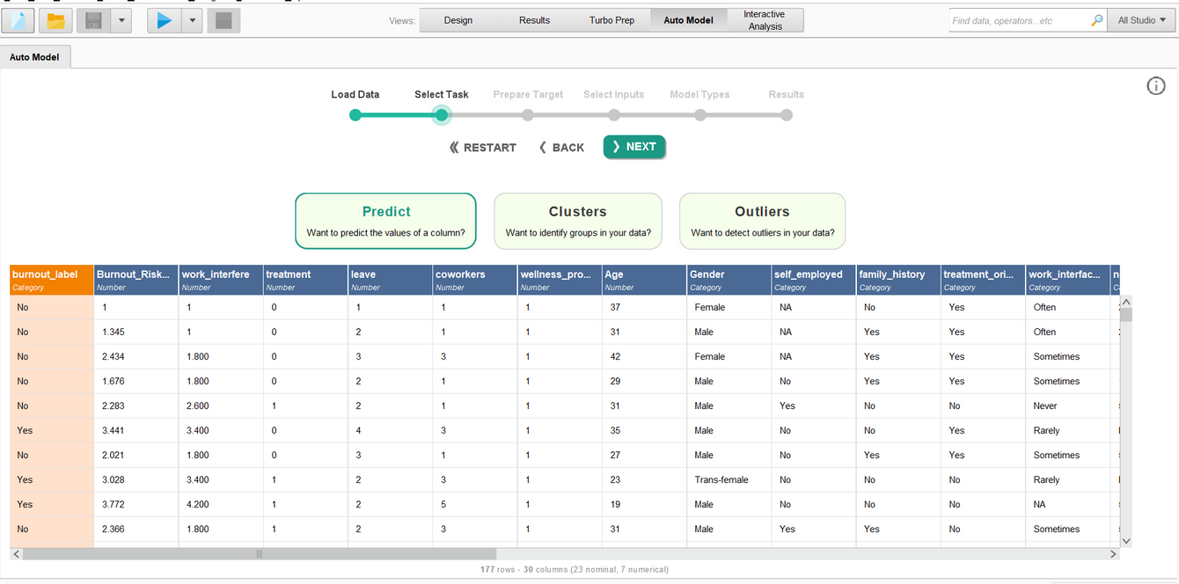
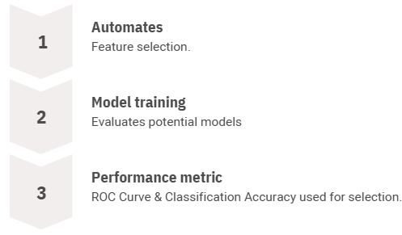

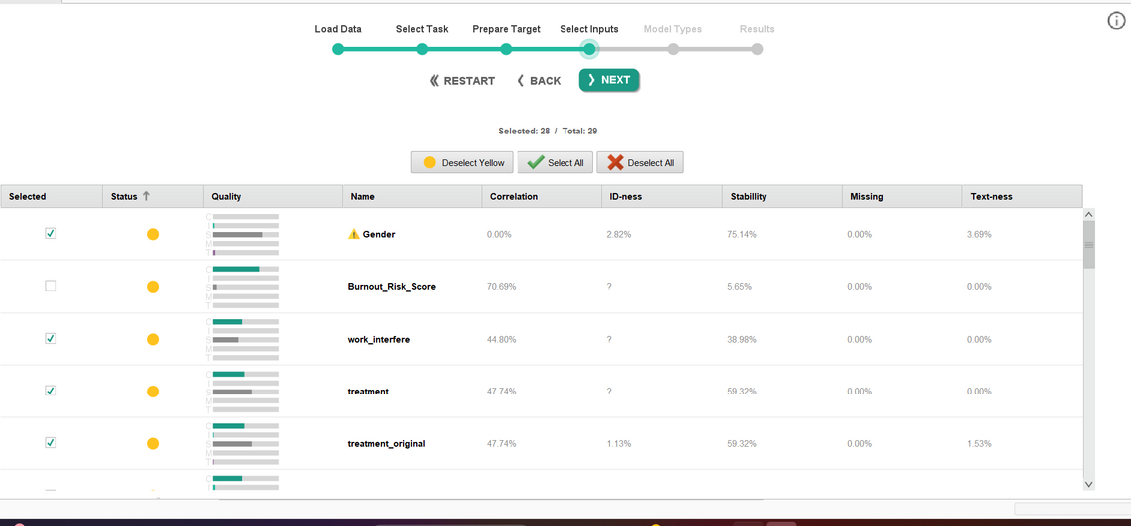

Auto Model Process in RapidMiner

Slide 8
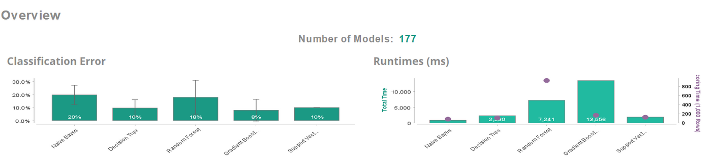
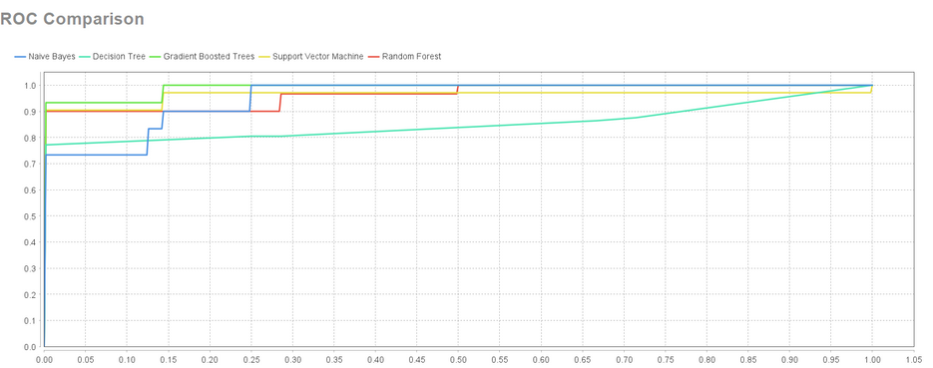
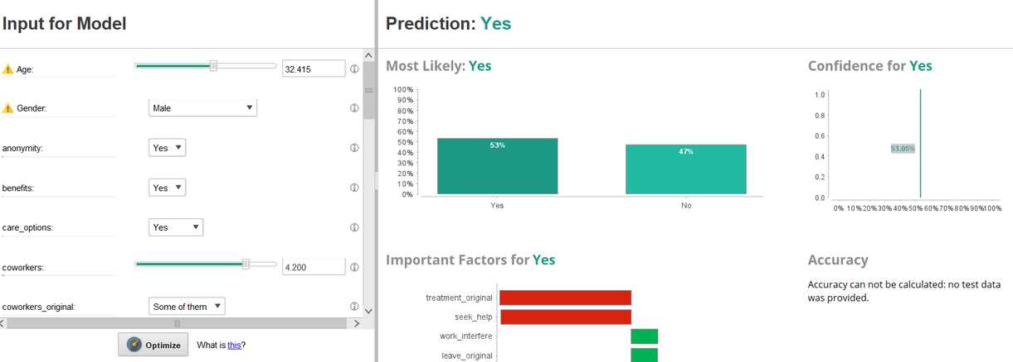
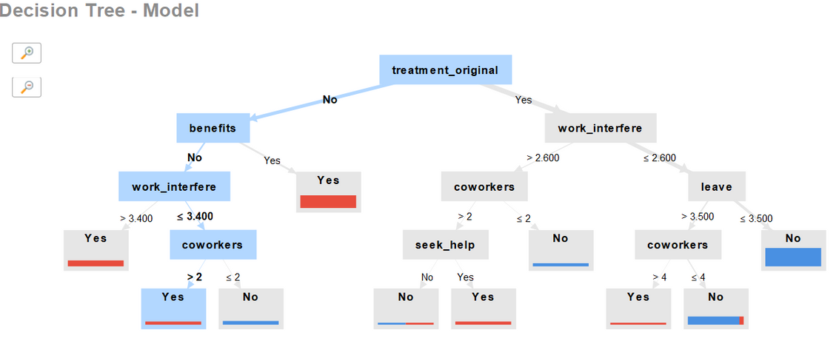
MODEL SELECTION : Based on accuracies and runtimes, I have selected the Decision Tree model. I saved the process to run it and evaluate its performance, predictions, and simulator results.
Simulator:

Slide 9

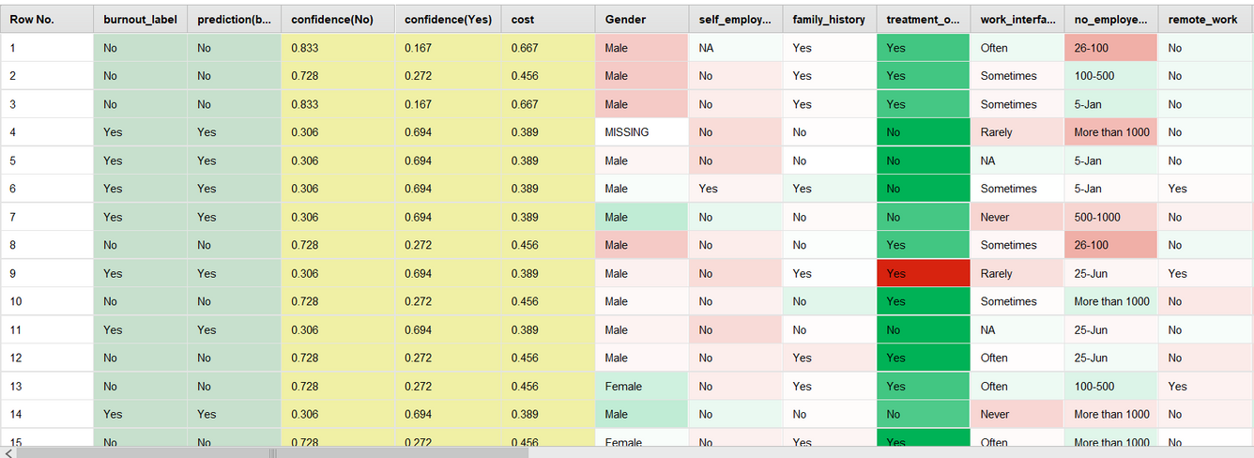
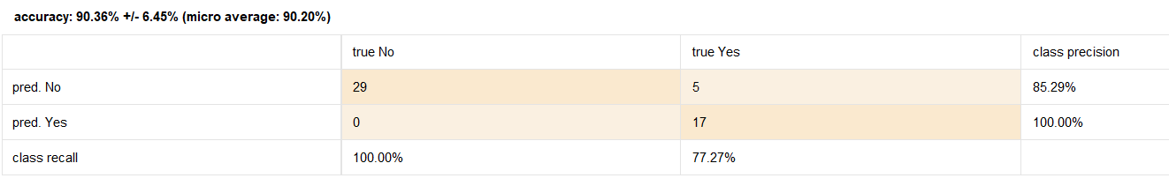
Model Performance
Predictions:
Model Performance
Accuracy: 90.36% ± 6.45% (Micro Average: 90.20%)
Classification Error: 9.64% ± 6.45% (Micro Average: 9.80%)
AUC (Area Under Curve): 0.853 ± 0.172 (Micro Average: 0.853) (Positive Class: Yes)
The Decision Tree model demonstrates high accuracy and a strong AUC score, indicating reliable classification performance.
Performance:

Slide 10
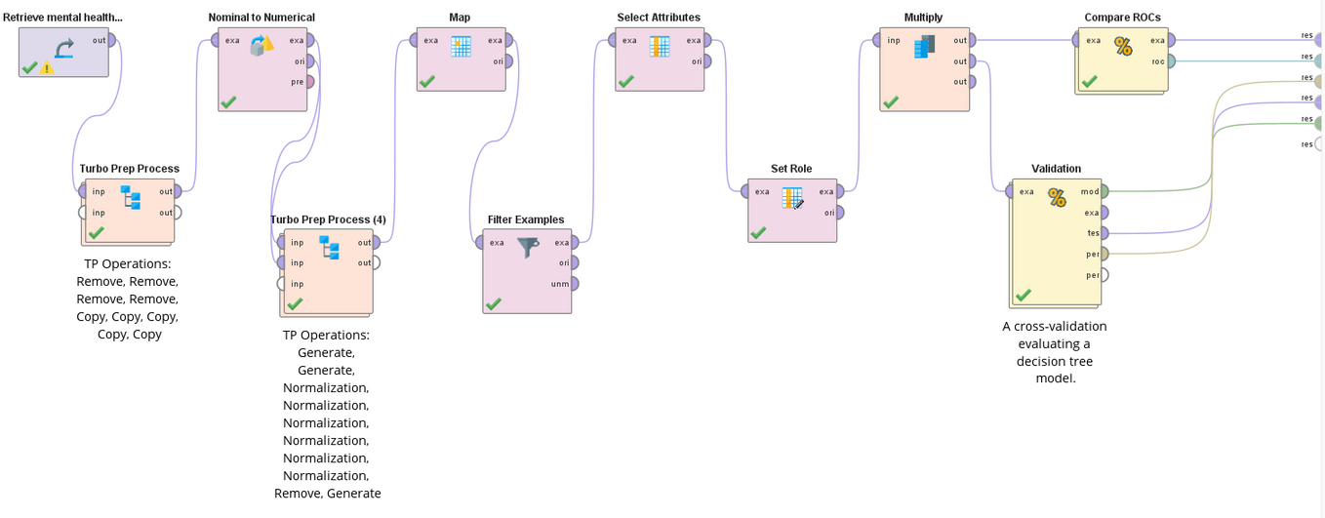
Custom Model Design in RapidMiner
To ensure robust model selection, we implemented:
ROC Curve Comparison: Evaluated multiple models based on their Receiver Operating Characteristic (ROC) curves to analyze classification performance.
Cross-Validation: Applied k-fold cross-validation to assess model consistency and prevent overfitting by testing performance across different data subsets.

Slide 11
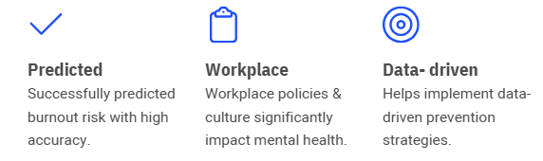
Conclusion
Key Insights
Model Performance
Efficiency Boost
Work interference, mental health benefits, and leave policies significantly impact employee well-being.
Decision Tree model achieved 90.36% accuracy, selected using ROC comparison
Altair’s Auto Model streamlined the process, making model selection and evaluation quick and effortless.

Slide 12
Thank You

